Slide 1
AlphaGo
Sungjoon Choi
(sungjoon.choi@cpslab.snu.ac.kr)
David Silver, et al. "Mastering the game of Go with deep neural networks and tree search." Nature 529.7587 (2016): 484-489.

Slide 2
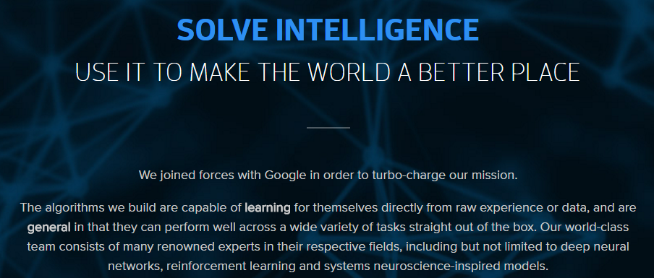
DeepMind

Slide 3
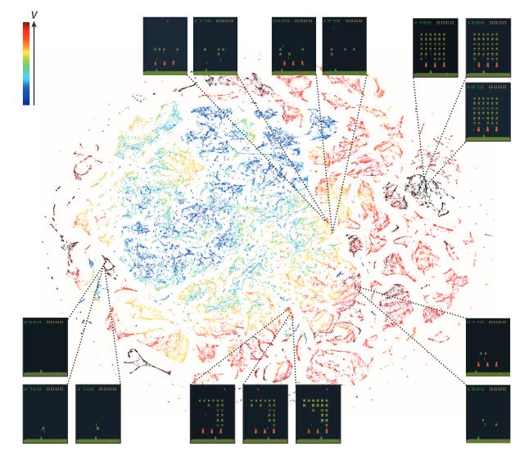
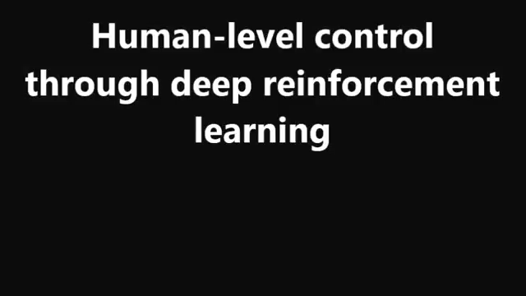
Prior Work of DeepMind
V. Mnih, K. Kavukcuoglu, D. Silver, A. A. Rusu, J. Veness, M. G. Bellemare, and S. Petersen (2015). Human-level control through deep reinforcement learning. Nature, 518(7540), 529-533.

Slide 4
Contents
Complexity of Go
Monte-Carlo Tree Search
Training Networks
Searching with policy and value networks
Experiments

Slide 5
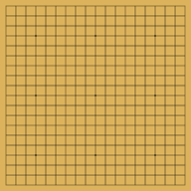
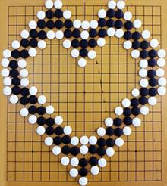
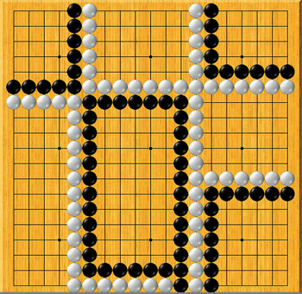
Complexity of Go

Slide 6
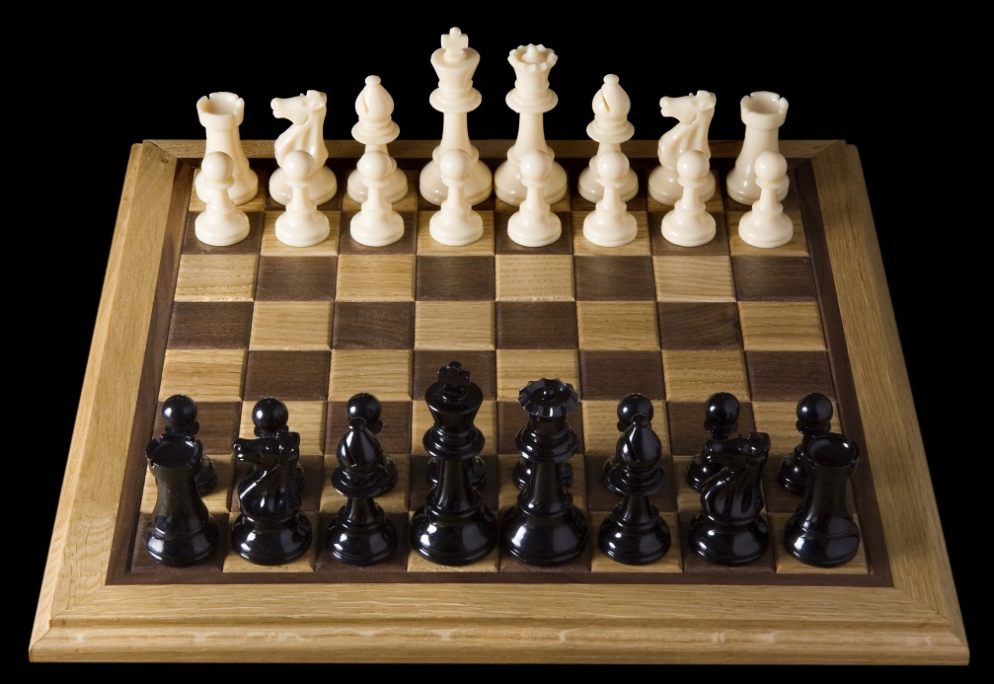
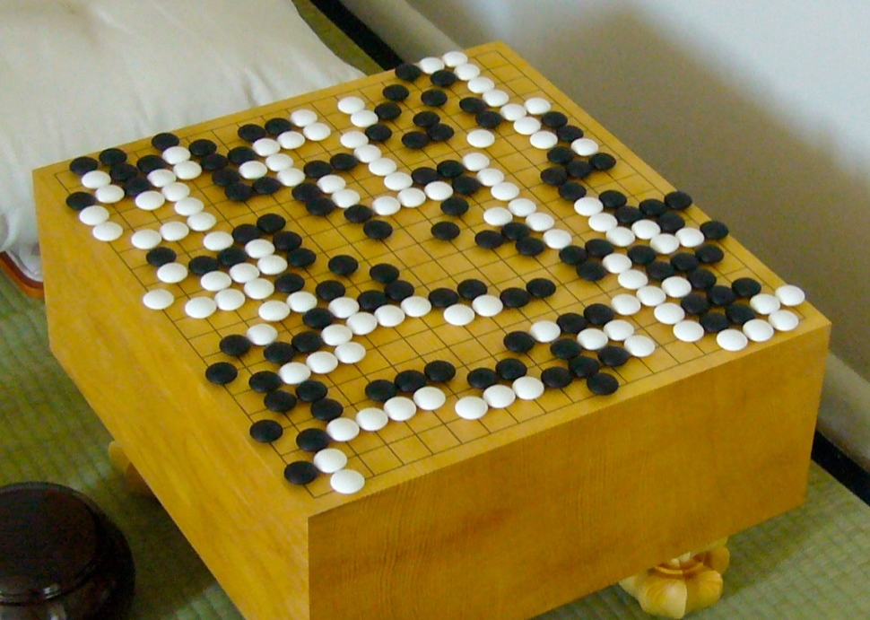
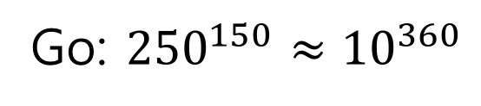
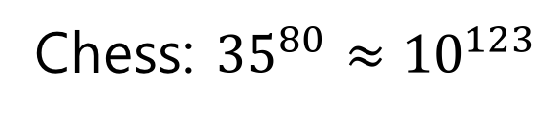
Complexity of Go
Chess: ${35}^{80}≈{10}^{123}$
Go: ${250}^{150}≈{10}^{360}$

Slide 7
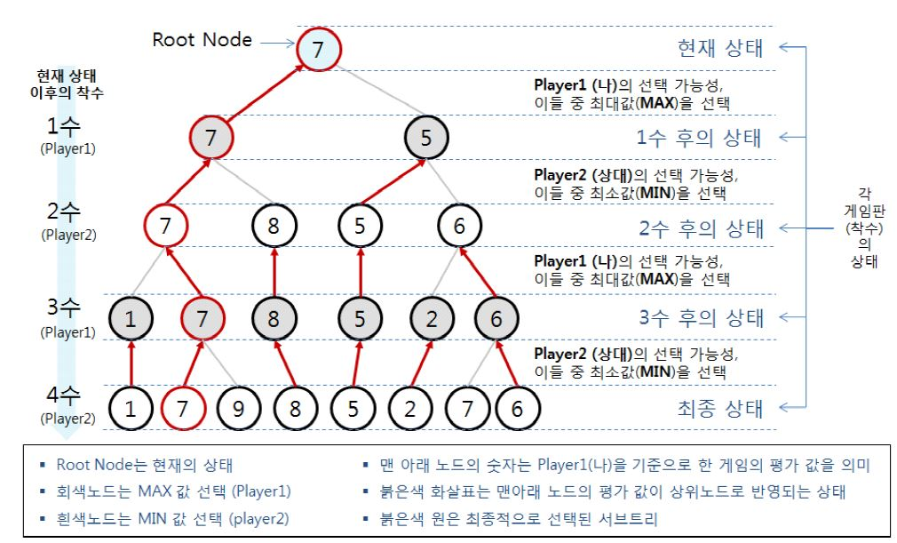
Monte-Carlo Tree Search

Slide 8
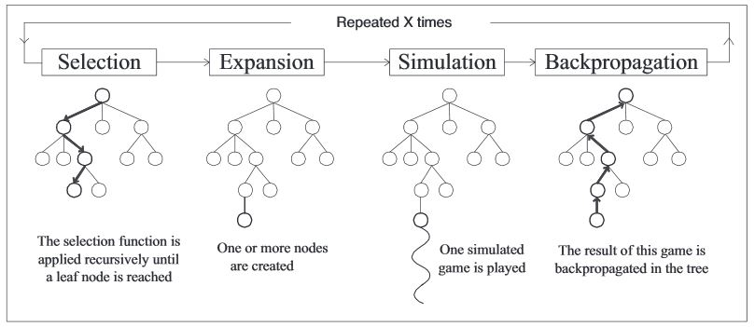
Monte-Carlo Tree Search
By some selection rule
By some expansion rule
By some simulation method

Slide 9
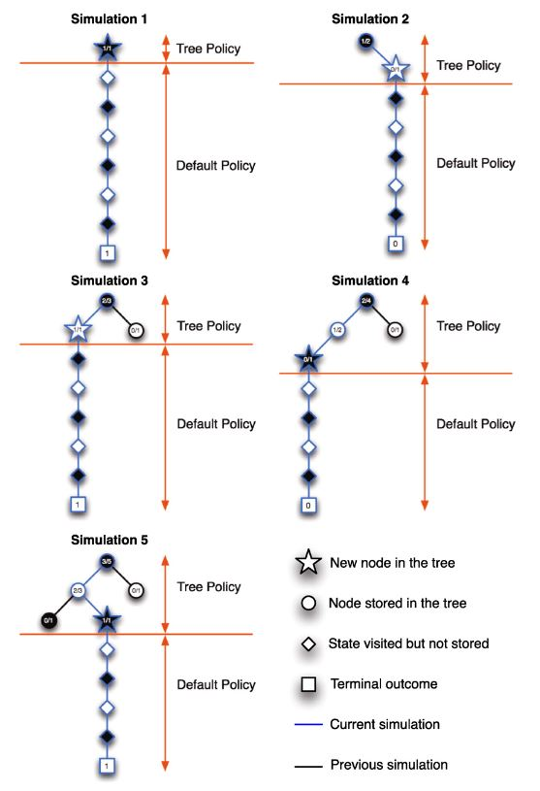
MCTS Example

Slide 10
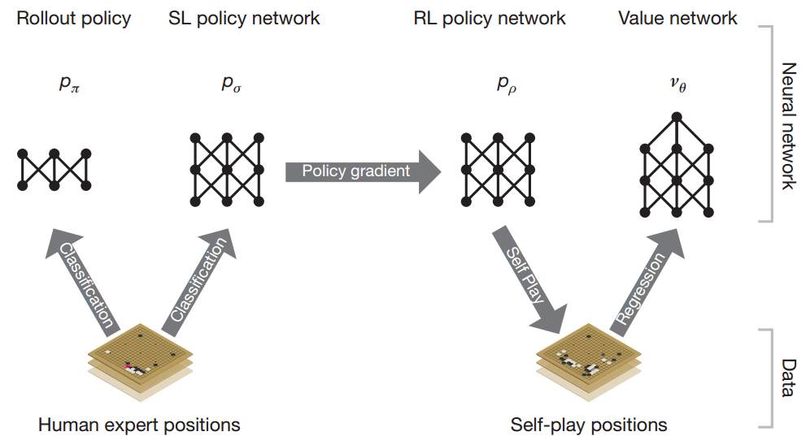
MCTS in AlphaGo

Slide 11
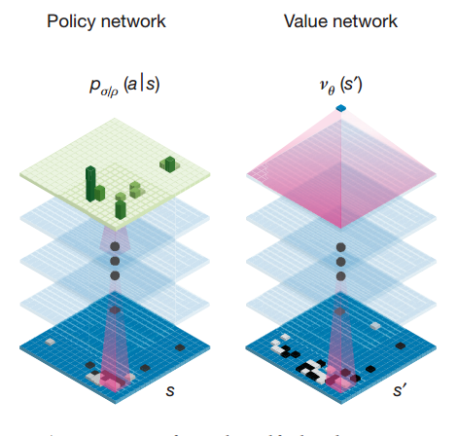
Policy Net & Value Net

Slide 12
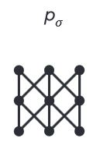
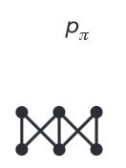
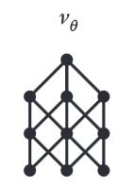
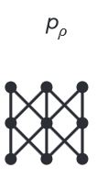
MCTS in AlphaGo
Rollout net
Value net
SL Policy Network
RL net

Slide 13
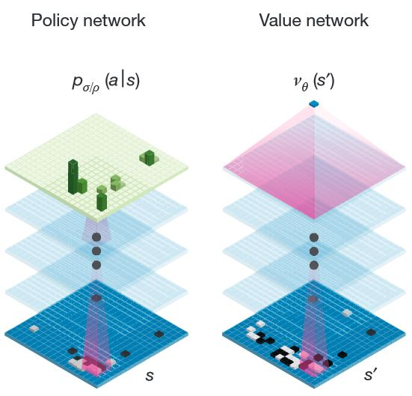
Training
Rollout Policy Network (Rollout net)
Supervised Learning Policy Network (SL net)
Reinforcement Learning Policy Network (RL net)
Value Network (Value net)
SoftMax (13)
Tanh, Fc (15)
ReLU, Fc (14)
3*3, 192 filter
stride 1, ReLU
(2 ~ 12)
No Info (12,13)
3*3, 192 filter
stride 1, ReLU
(2~11)
5*5, 192 filter
stride 1, ReLU(1)
5*5, 192 filter
stride 1, ReLU(1)

Slide 14
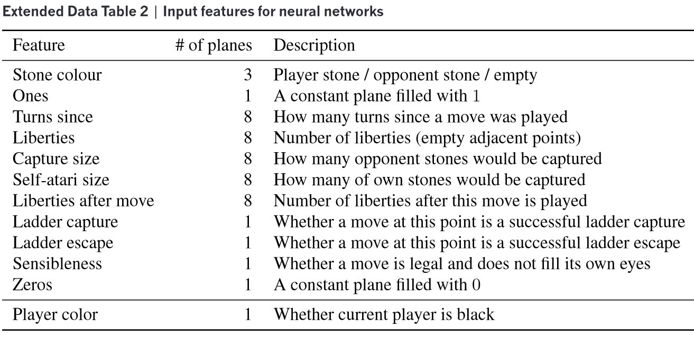
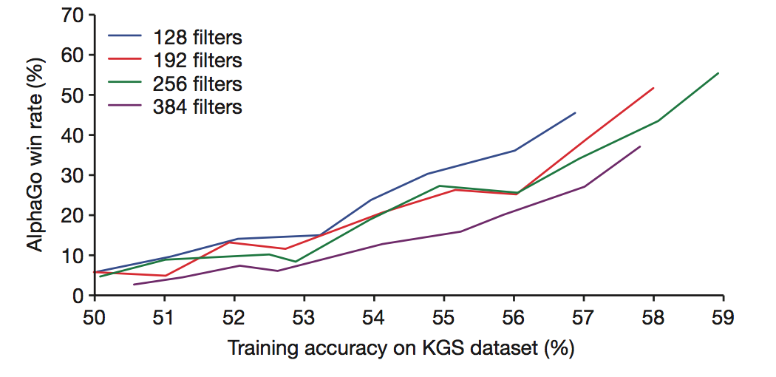
Input Features
The net- work predicted expert moves on a held out test set with an accuracy of 57.0% using all input features, and 55.7% using only raw board position and move history as inputs, compared to the state-of-the-art from other research groups of 44.4%

Slide 15
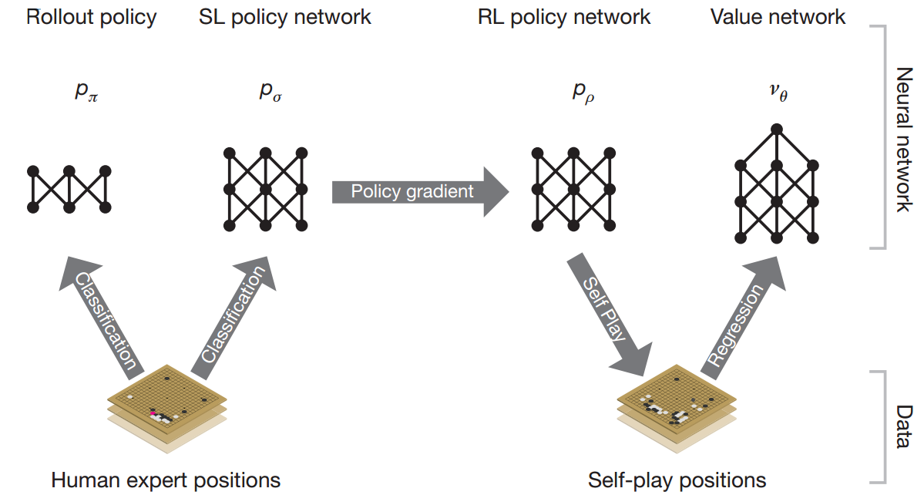
Training

Slide 16
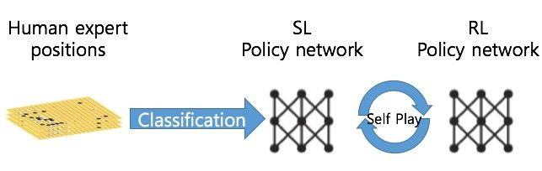
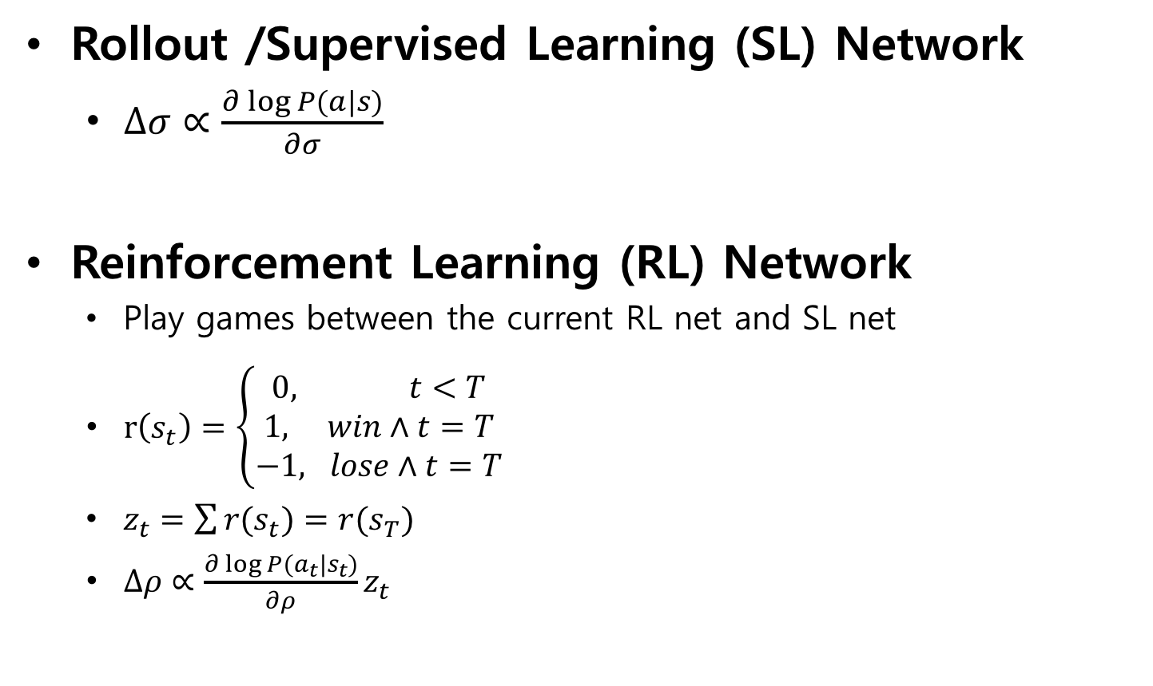
Training policy nets
Rollout /Supervised Learning (SL) Network
$∆σ∝\frac{∂\log{P(a|s)}}{∂σ}$
Reinforcement Learning (RL) Network
Play games between the current RL net and SL net
$r\left(s_{t}\right)=\left\{\begin{aligned}0, t<T \\ 1, win∧t=T \\ &−1, lose∧t=T\end{aligned}\right.$
$z_{t}=\sum{r(s_{t})}=r(s_{T})$
$∆ρ∝\frac{∂\log{P(a_{t}|s_{t})}}{∂ρ}z_{t}$
Policy Gradient Reinforcement Learning
“We also tested against the strongest open-source Go program, Pachi14, a sophisticated Monte Carlo search program, ranked at 2 amateur dan on KGS, that executes 100,000 simulations per move. Using no search at all, the RL policy network won 85% of games against Pachi.”

Slide 17
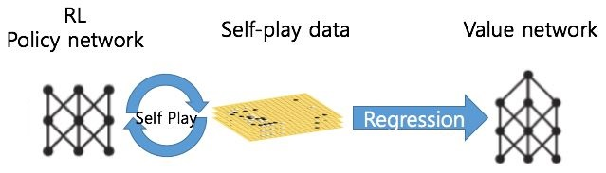
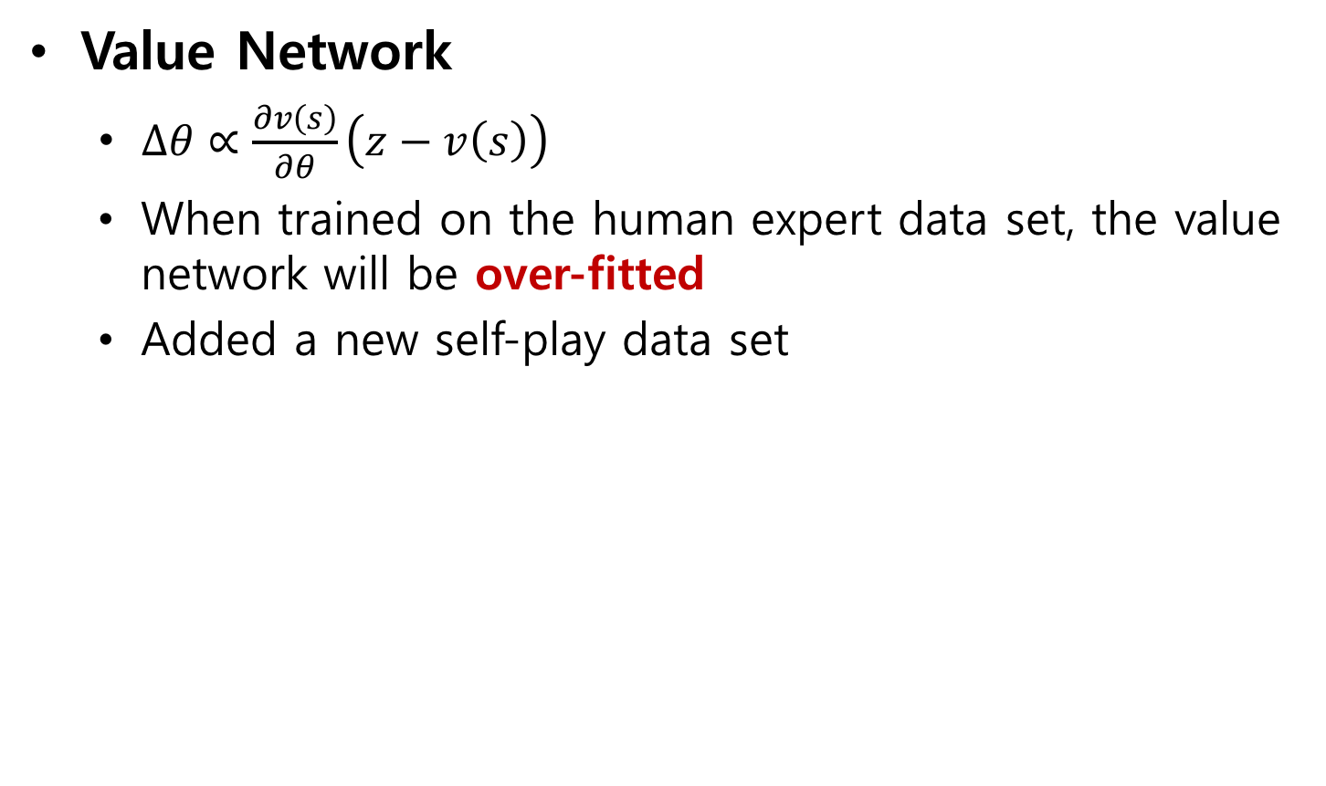
Training value nets
Value Network
$∆θ∝\frac{∂v\left(s\right)}{∂θ}\left(z−v\left(s\right)\right)$
When trained on the human expert data set, the value network will be over-fitted
Added a new self-play data set

Slide 18
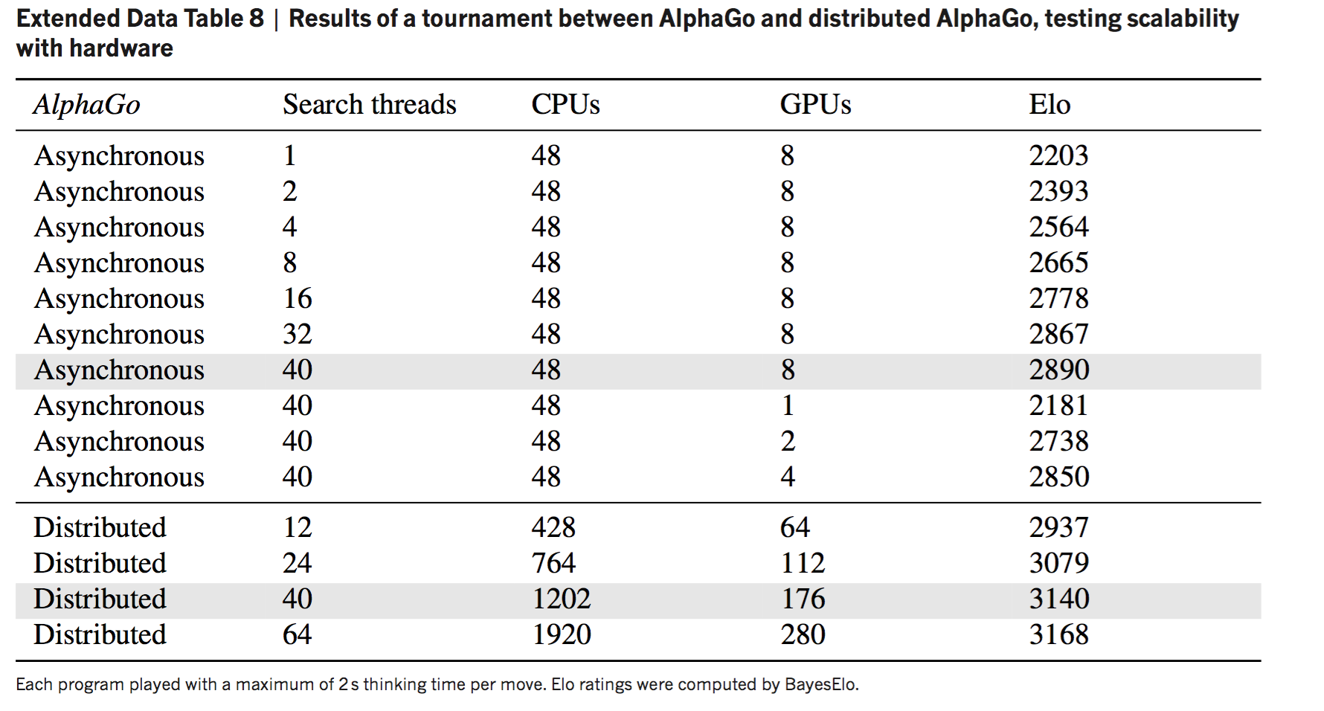
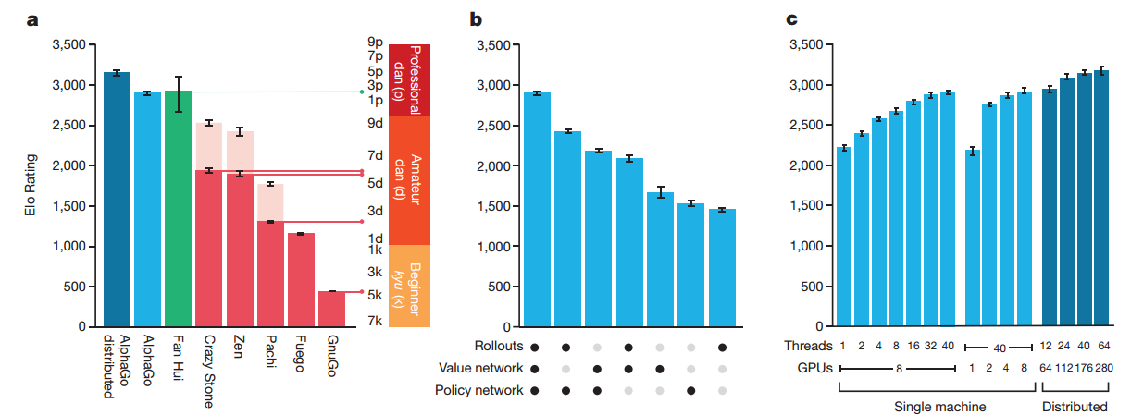
Computational Power
Distributed AlphaGo
40 search threads, 1,202 CPUs, 176 GPUs
Training Policy Net
50 GPUs, one day
Training Value Net
50 GPUs, one week
2 second thinking

Slide 19
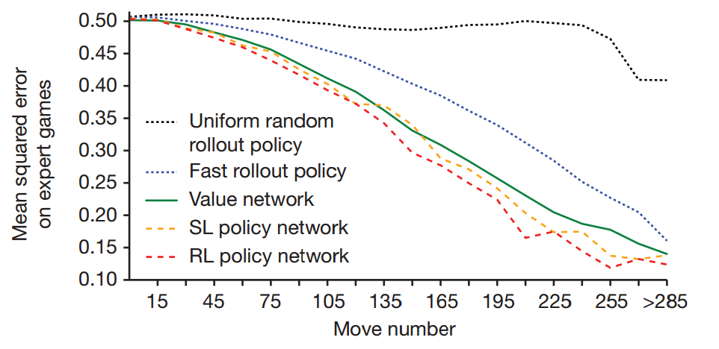
Game Result Prediction
For policy networks, predictions were averaged with 100 rollouts.

Slide 20
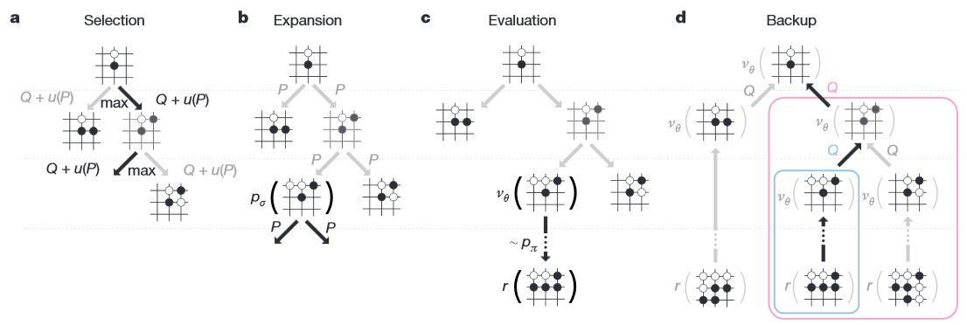
Execution phase

Slide 21
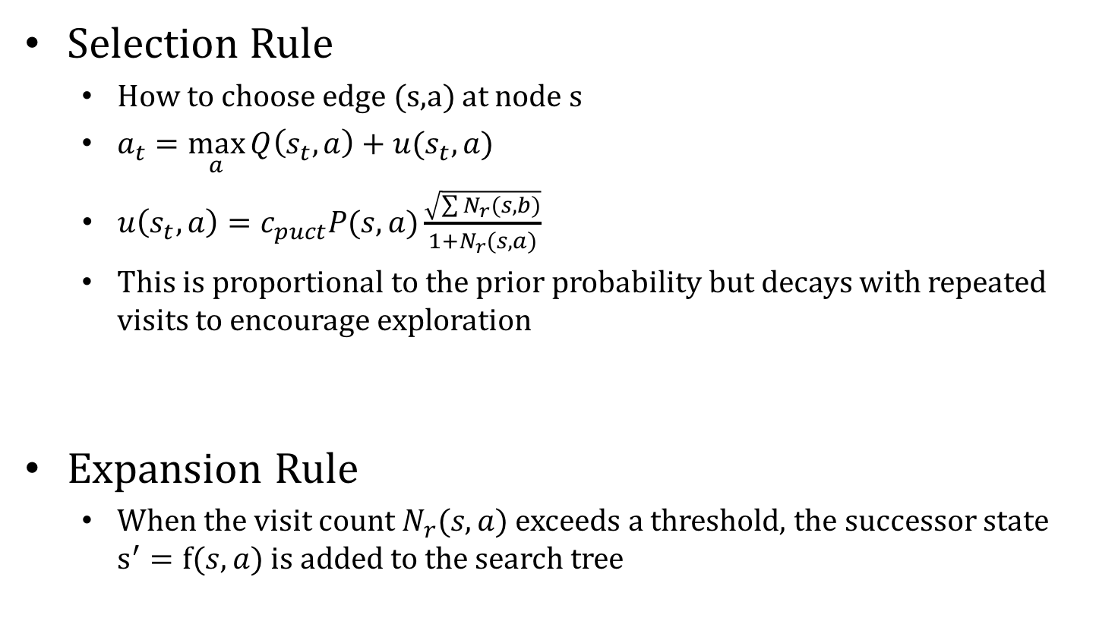
Execution phase
Selection Rule
How to choose edge (s,a) at node s
$a_{t}=\max_{a}{Q\left(s_{t},a\right)}+u(s_{t},a)$
$u\left(s_{t},a\right)=c_{puct}P(s,a)\frac{\sqrt{\sum{N_{r}(s,b)}}}{1+N_{r}(s,a)}$
This is proportional to the prior probability but decays with repeated visits to encourage exploration
Expansion Rule
When the visit count $N_{r}(s,a)$ exceeds a threshold, the successor state $s^{′}=f(s,a)$ is added to the search tree

Slide 22
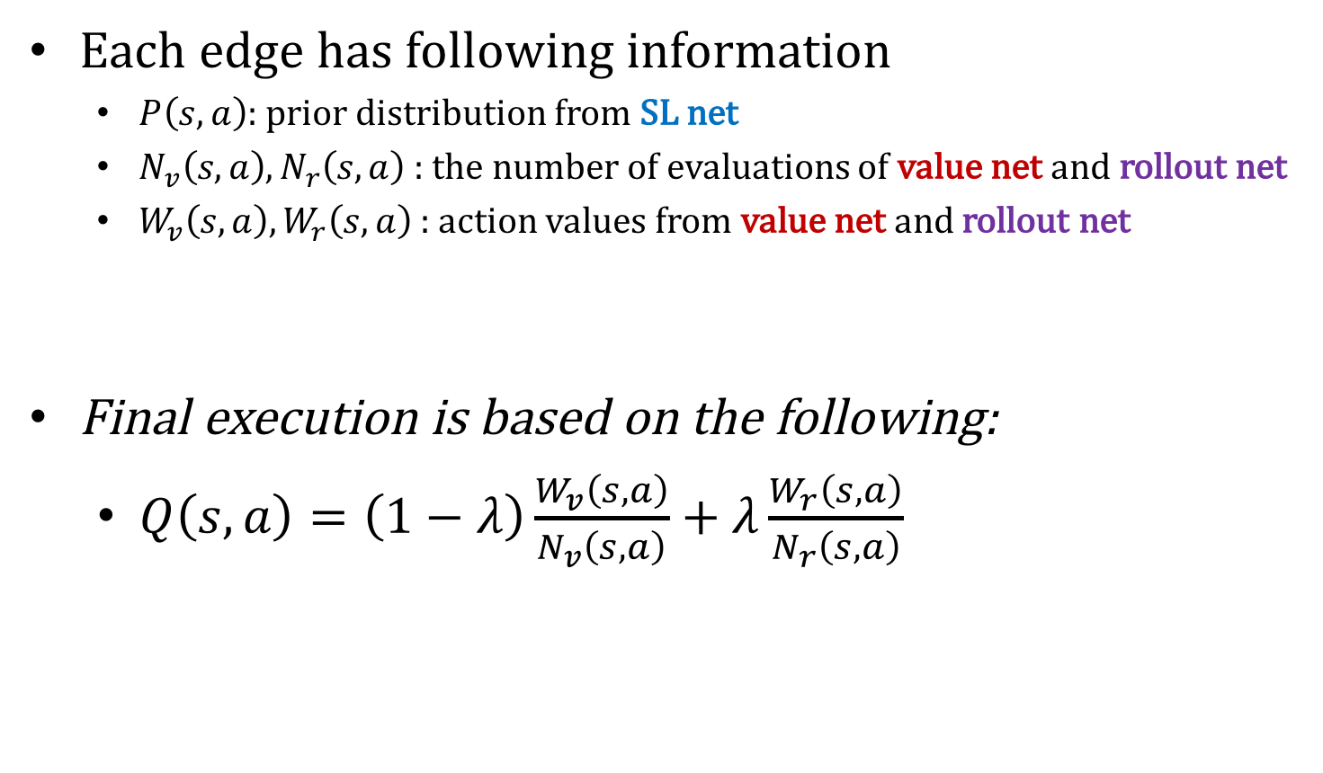
Execution phase
Each edge has following information
$P\left(s,a\right)$: prior distribution from SL net
$N_{v}\left(s,a\right),N_{r}\left(s,a\right)$ : the number of evaluations of value net and rollout net
$W_{v}\left(s,a\right),W_{r}\left(s,a\right)$ : action values from value net and rollout net
Final execution is based on the following:
$Q\left(s,a\right)=\left(1−λ\right)\frac{W_{v}\left(s,a\right)}{N_{v}\left(s,a\right)}+λ\frac{W_{r}\left(s,a\right)}{N_{r}\left(s,a\right)}$

Slide 23
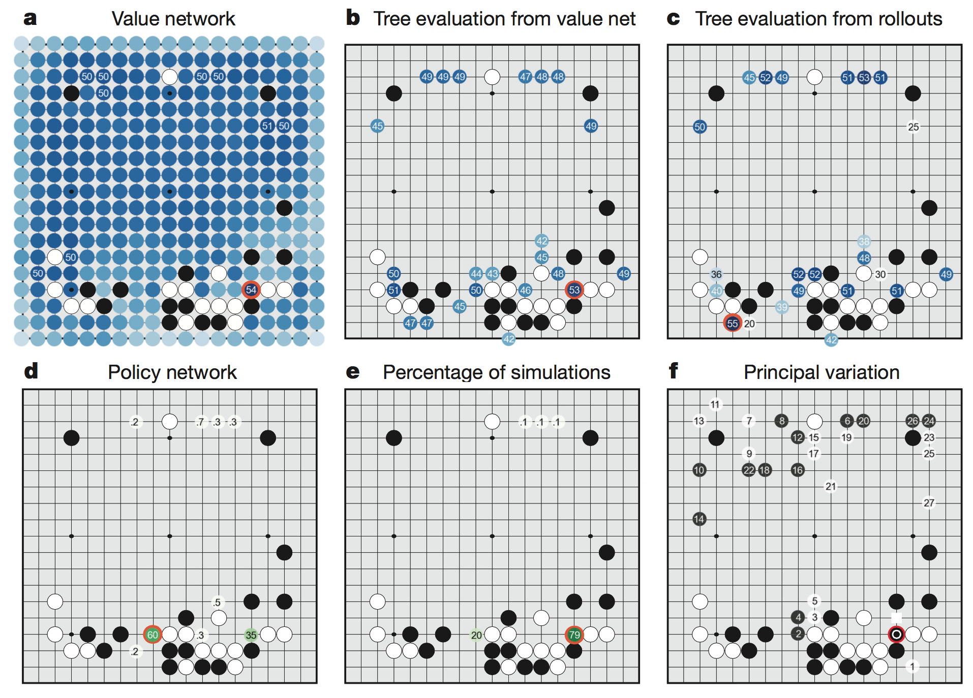
How AlphaGo play
a) Evaluation of all successors s′ of the root position s, using the value network v(s′); estimated winning percentages are shown for the top evaluations.

Slide 24
How AlphaGo play
b) Action values Q(s, a) for each edge (s, a) in the tree from root position s; averaged over value network evaluations only (λ = 0).

Slide 25
How AlphaGo play
c) Action values Q(s, a), averaged over rollout evaluations only (λ = 1).

Slide 26
How AlphaGo play
d) Move probabilities directly from the SL policy network; reported as a percentage (if above 0.1%).

Slide 27
How AlphaGo play
e) Percentage frequency with which actions were selected from the root during simulations.

Slide 28
How AlphaGo play
f) , The principal variation (path with maximum visit count) from AlphaGo’s search tree. The moves are presented in a numbered sequence. AlphaGo selected the move indicated by the red circle; Fan Hui responded with the move indicated by the white square which was predicted by AlphaGo.

Slide 29
Result
Evaluation of playing strength of AlphaGo
Single-machine AlphaGo: 99.8%
With four handicap stones: 77%, 86% and 99% (vs CrazyStone, Zen and Pachi)
Distributed AlphaGo: 77% (vs Single-machine), 100% (vs Others)

Slide 30
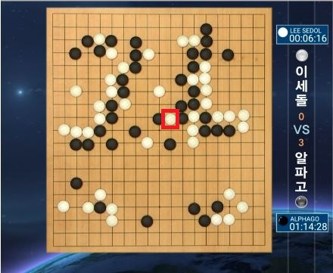
Result
Match score: AlphaGo 4 - Lee Sedol 1

Slide 31

Conclusion

